Slide 1


Investigate Business Hotel using Data Visualization
Created by:
Wika Rabila Putri
rabilaputri@gmail.com
https://www.linkedin.com/in/wika-rabila-putri/
As a fresh graduate in Financial Management, I am eager to dive into the dynamic world of data and business analytics. I am at the start of my journey, focusing on building a strong foundation in SQL, Python, and Data Visualization. My training and virtual internship experiences have equipped me with practical skills, and I am enthusiastic about applying them to create innovative solutions that enhance business decision-making. My passion for continuous learning drives me to contribute meaningfully to any data-driven environment.

Slide 2
Table of Content
Overview
Data Preprocessing
Monthly Hotel Booking Analysis Based on Hotel Type
Impact Analysis of Stay Duration on Hotel Bookings Cancelation Rate
Impact Analysis of Lead Time on Hotel Bookings Cancellation Rate

Slide 3
Overview
The hospitality industry is a highly competitive sector that requires continuous analysis to maintain profitability and customer satisfaction. With the rise of digital booking platforms and large datasets, we can leverage data visualization to gain deeper insights. Our focus is to understand customer behavior in hotel bookings and its relationship to booking cancellation rates.

Slide 4
Data Preprocessing
Data Overview: 2017 – 2019 The dataset contains 119.390 entries with 29 columns/features. The data types include object, int64, and float64. There are 33.261 duplicate entries in the dataset.
Data pre-processing |  | Handling
Missing values | children (4), agent (16.340), company (112.593), dan city (488). | children: Null values filled with 0, indicating no children were brought by the guests. agent: Null values filled with 0, indicating reservations were made independently or not through an agent. company: Null values filled with 0, indicating the guests did not come from a company. city: Null values filled with 'Undefined', indicating the city is unknown.
Inconsistent and extream values | ‘Undefined’ in the meal column. | Categorized into 2 groups: With Meal (Breakfast, Full Board, Dinner) and No Meal (No Meal, Undefined).
Data anomalies | Negative values and outliers significantly distant from the data distribution in the adr column. There are 180 booking entries with no guest information. | Drop (remove) rows data
click here to view the code

Slide 5
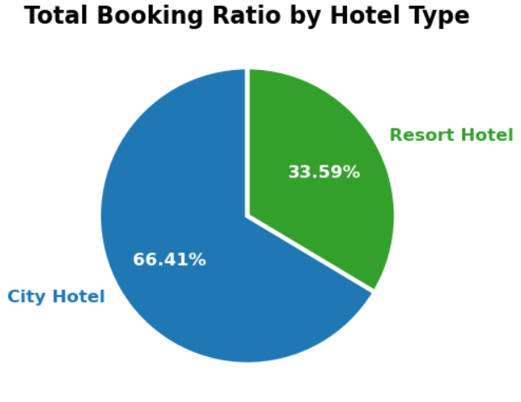
Monthly Hotel Booking Analysis Based on Hotel Type
City Hotels account for a larger share of total bookings compared to Resort Hotels.
This indicates a strong preference for City Hotels, which may be attributed to their strategic locations and good accessibility, making them ideal for business travelers or visitors exploring shopping areas and city attractions.
Modern amenities such as fitness centers, restaurants, and comprehensive room services at City Hotels also attract guests seeking comfort and convenience during their stay.
On the other hand, Resort Hotels might be less popular due to higher prices or limited availability, especially during peak holiday seasons. Guests booking Resort Hotels are likely seeking vacation and relaxation experiences, as these hotels are often located in serene settings such as beachside, mountainous, or rural areas, and offer extensive facilities to meet their vacation needs.
click here to view the code

Slide 6
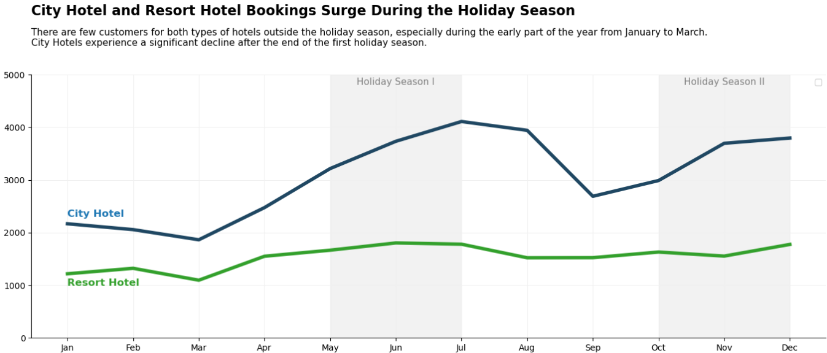
Monthly Hotel Booking Analysis Based on Hotel Type
During the holiday season, hotel booking demand typically surges. From May to August, the booking period is the busiest for both types of hotels, with a significant increase especially for City Hotels. This spike is driven by school vacations, numerous national holidays such as collective leave, and religious celebrations like Ramadan and Eid between 2017-2019, providing ample opportunities for people to travel and book hotels. Meanwhile, the October to December holiday season coincides with Christmas and New Year's.
From January to March, booking levels are at their lowest, largely due to the lack of national holidays, the start of the new school year for students, and generally less busy business travel activities early in the year.
click here to view the code

Slide 7
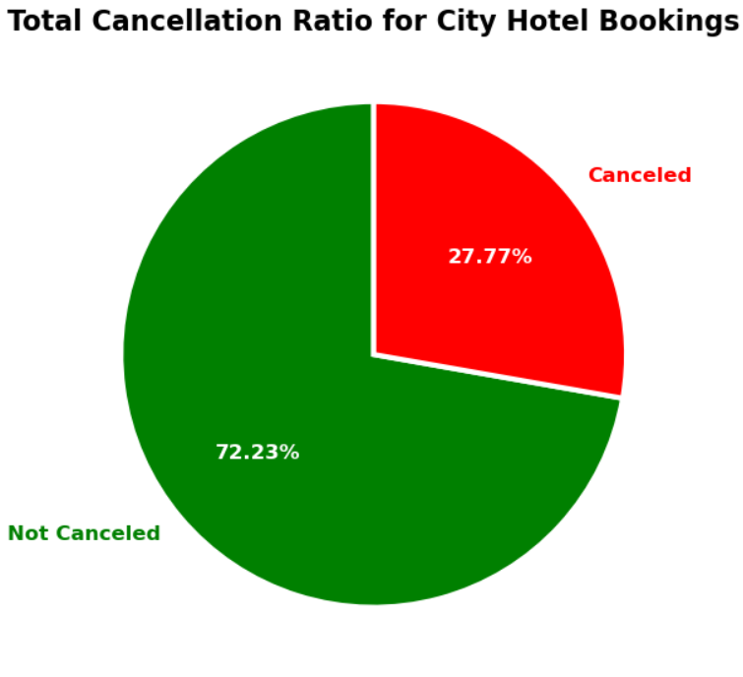
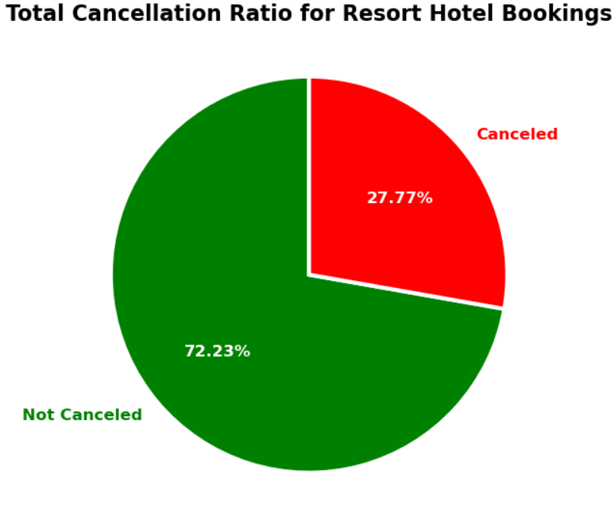
Impact Analysis of Stay Duration on Hotel Bookings Cancelation Rate
Monthly Hotel Booking Analysis Based on Hotel Type
A higher cancellation ratio at City Hotels (41.79%) compared to Resort Hotels (27.77%) indicates that guests are more likely to cancel bookings at City Hotels. This may be due to several factors:
City Hotels are typically located in city centers with numerous other accommodation options nearby. Guests might find it easier to cancel and choose another hotel in the vicinity.
Many guests at City Hotels are likely to be business travelers, whose plans are more prone to changes or cancellations.
Resort Hotels have a lower cancellation rate (27.77%), indicating that guests are generally more committed to their plans.
Resort Hotels are typically chosen for vacations planned well in advance. Guests are more certain about their vacation schedules, which reduces the likelihood of cancellations.
Additionally, Resort Hotels are often located in exclusive areas such as beaches or mountains, making it more difficult for guests to find comparable alternatives.
click here to view the code

Slide 8
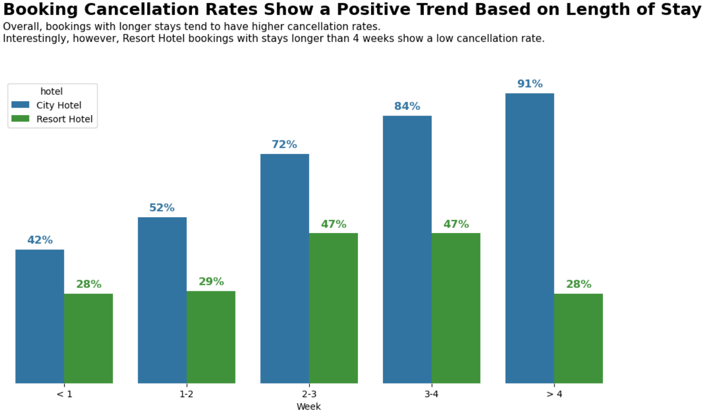
Impact Analysis of Stay Duration on Hotel Bookings Cancelation Rate
The stay duration in hotels has 42 unique values, with a maximum of 69 days and a minimum of 0 days. This indicates significant variation in the length of guest stays. To facilitate interpretation, the stay durations will be grouped into weekly categories as follows:
< 1 = 0 - 7 days
1 - 2 = 8 - 14 days
2 - 3 = 15 - 21 days
2 - 4 = 22 - 28 days
> 4 = More than 28 days
The high cancellation rate for longer stays at City Hotels indicates a greater level of uncertainty and changes in guests' plans, likely due to business travel. In contrast, Resort Hotels show a lower overall cancellation rate, reflecting higher commitment from guests who are on vacation.
click here to view the code

Slide 9
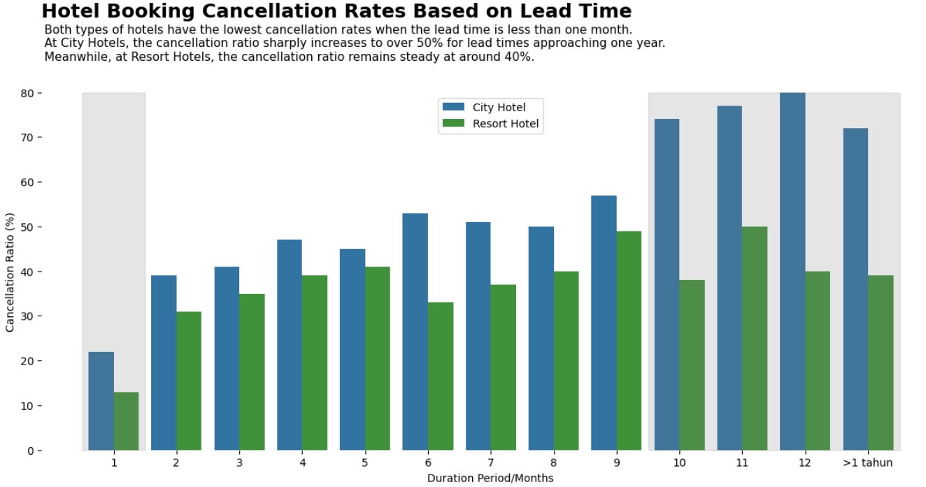
Impact Analysis of Lead Time on Hotel Bookings Cancellation Rate
Monthly Hotel Booking Analysis Based on Hotel Type
Lead time ranges from 0 to 709 days. To simplify interpretation, lead time will be categorized by month .
City Hotels dominate the cancellation rates, with cancellations tending to increase as lead time approaches one year. Conversely, cancellations remain low for lead times of less than one month. Considering this trend, the company may want to implement a maximum booking lead time to mitigate the risk of cancellations due to changes in plans or the discovery of more attractive hotel options for customers.
click here to view the code

